Slide 1
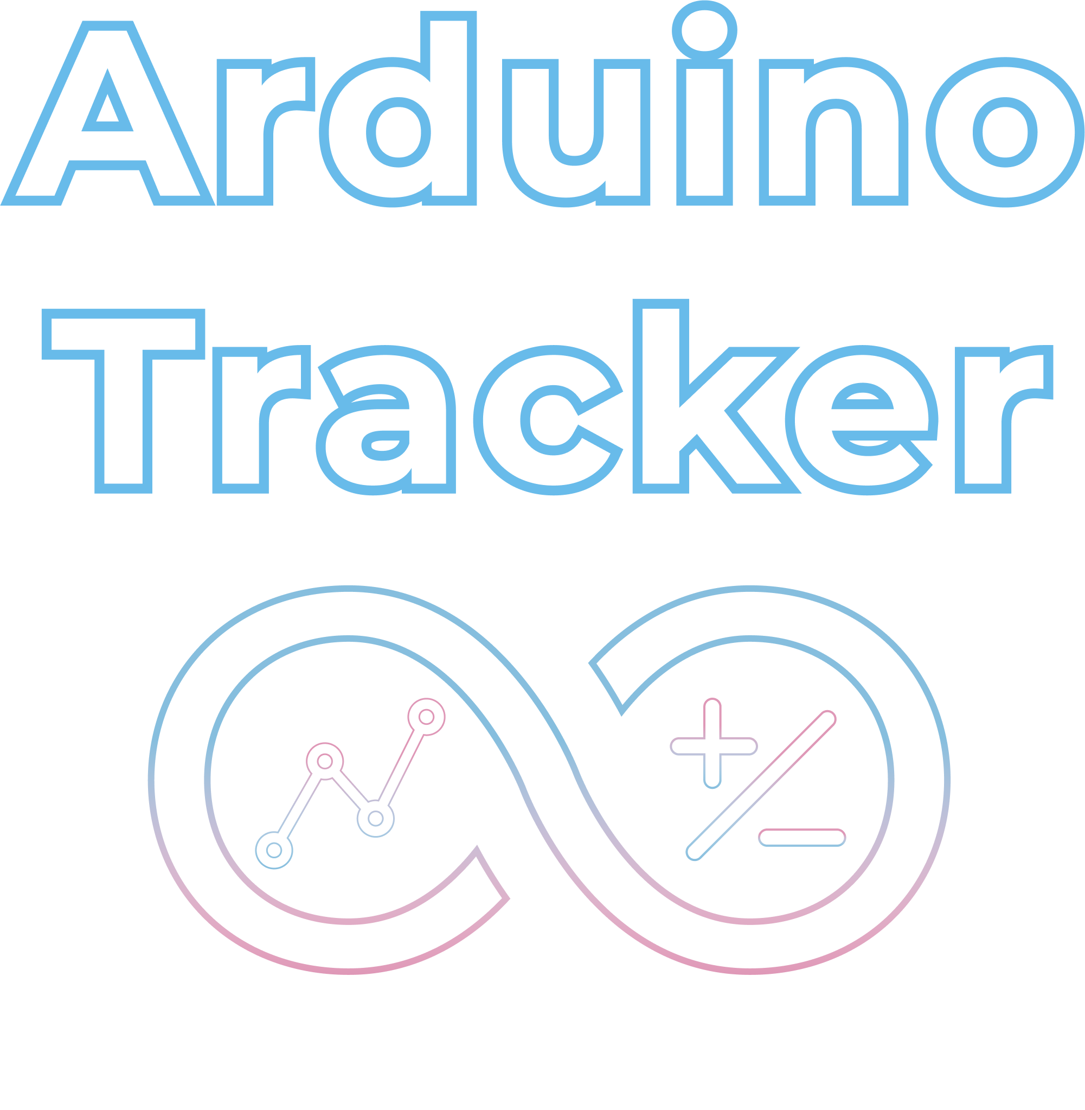
Andrew Bertella
Tyler Woodby
Jude Agan
Wesley Hataway

Slide 2
Purpose
This project implements a simple IOT event tracking device that could be useful for Nest-like applications.
We used an ESP8266 Node MCU and a humidity sensor to prove the application concept.
The events from the microcontroller are posted to a MongoDB instance which can then be accessed and visualized through the application frontend.

Slide 3
Technology Stack
Microcontroller
Micropython
JSON
Python - sockets
Frontend
CSS
HTML
Bootstrap
Chart.js
jquery
Backend
MongoDB/Flask-Pymongo
Python
Flask

Slide 4
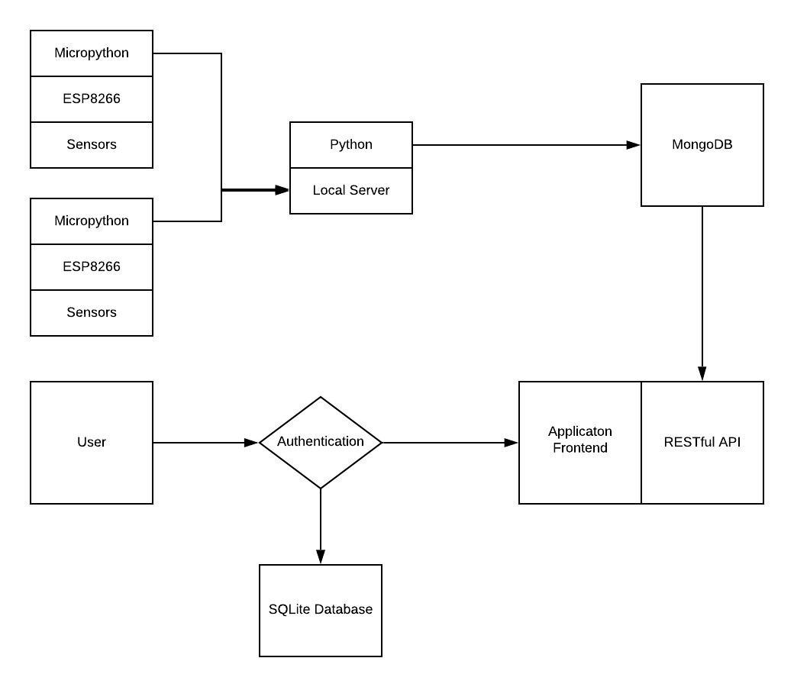
Block Diagram

Slide 5
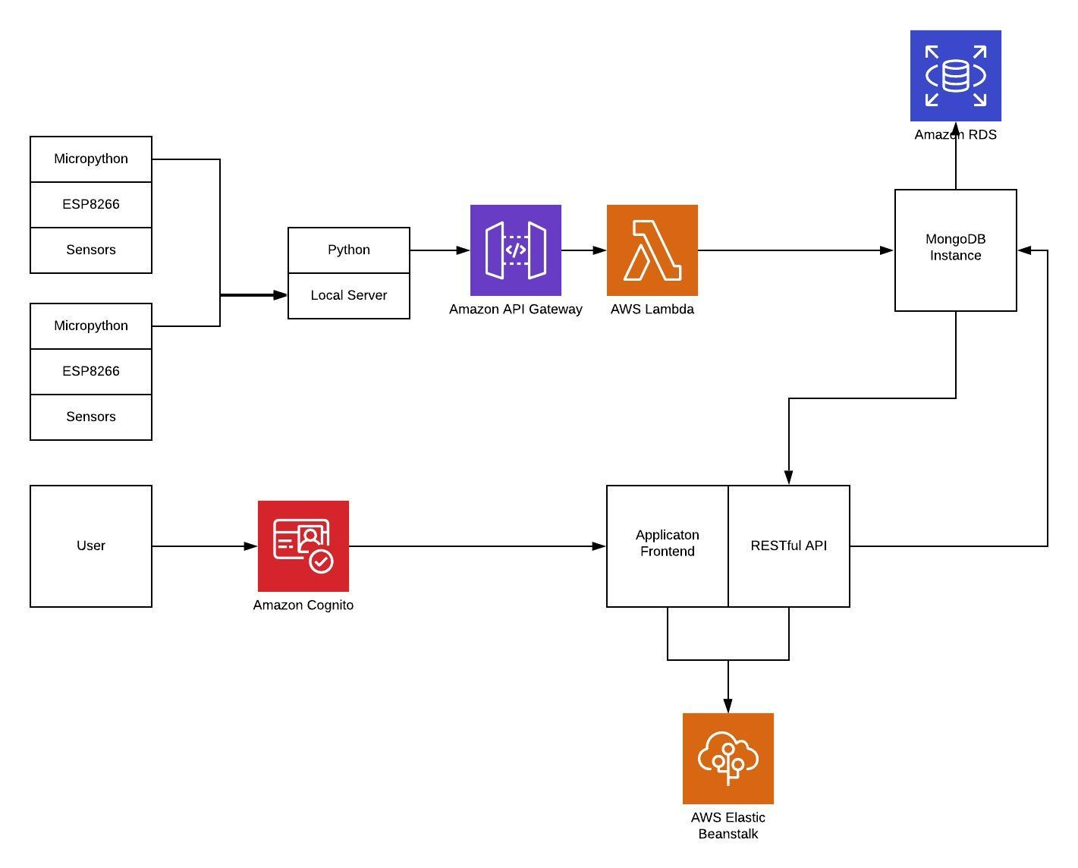
Example Deployment Model

Slide 6
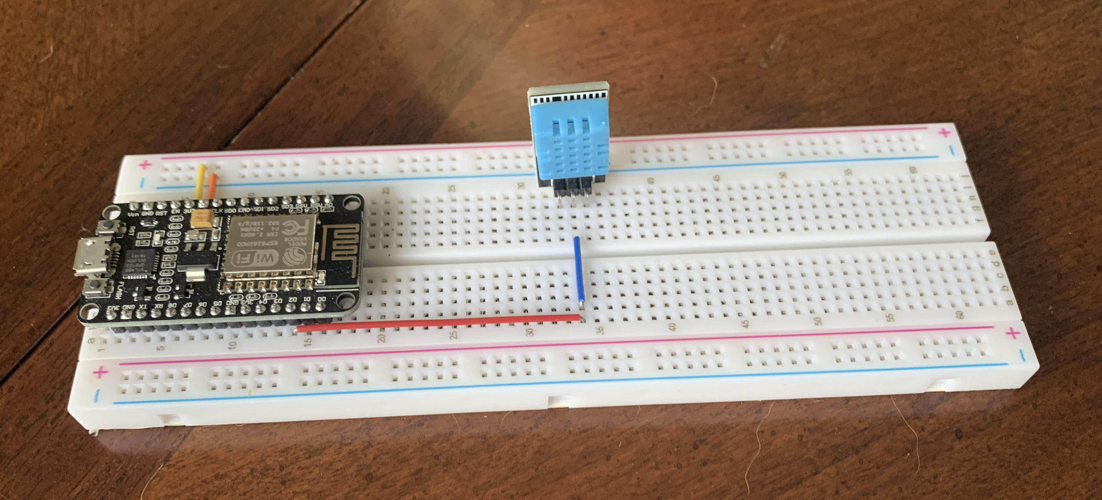
Device Setup

Slide 7

Demo - Microcontroller posting to server

Slide 8
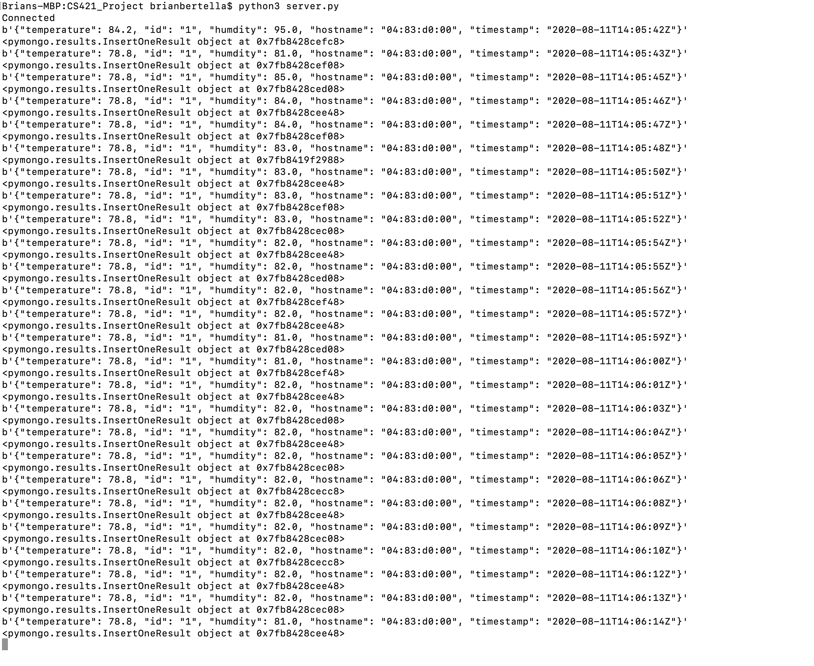
Demo - More device posting to server

Slide 9
Demo - Login/Signup/Homepage

Slide 10
Demo - More Hompage
Data can be filtered by category

Slide 11
Backend for visualization
visualization is created using a library called chart.js
Data is retrieved from our MongoDB instance
Jquery is then used to grab the data pulled from MongoDB
The data is updated on an interval and the visualization updates in real time (when the arduino is running)

Slide 12
Contributions
Andrew Bertella - Microcontroller, backend, database
Jude Agan - Data visualization design and implementation, CSS
Tyler Woodby - Sign up functionality/ Login functionality/ css/ html
Wesley Hataway - Login/signup functionality, CSS, html

